Slide 1

Garbage Collection System
Eco Clean
JUN_WE_02

Slide 2
Our Team
IT Number | Name
IT21170584 | Sithumini K.G.P
IT21173318 | Adhikari A.M.S.S
IT21700156 | Nanayakkara A.A.R
IT21156724 | Shehani W.G.P
1

Slide 3


Introduction
Brief Introduction About the selected topic
Functions
Functions assigned to the each group member
Content
Wireframes
Wireframes of the given functions
Description
Brief Introduction About the functions and wireframes
2

Slide 4
Introduction
What are we plan to make ?!
3

Slide 5
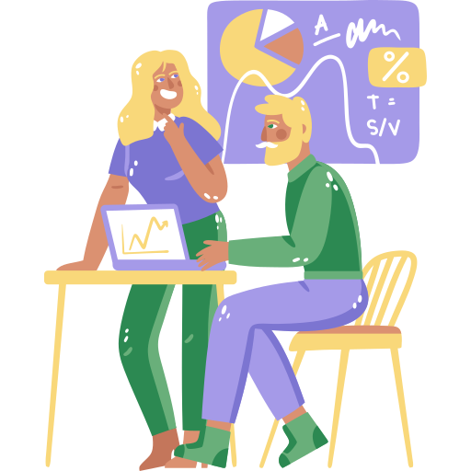
Introduction
Topic :
Garbage Management System
Application Name :
Eco Clean
4

Slide 6
Functions
What are the functions we got
5

Slide 7



Functions - Sithumini K.G.P
Novelties : Track garbage bins status using sensors
QR Code Scanner
QR scanner for give introduction about the app and instructions.
Home Page and Contact Page
Home page of the user
Contact admin
Instructions about the recycling and garbage management.
Track garbage bin status like sensor damage, either bin is full or not.
Using Wi-Fi through GPS tracking.
Using ultra sonic sensor and ESP sensor.
Education
Be able to contact and book admin for environmental education or seminar session
Multi User Login and Registration
User Collector Admin separate login
User Account Management
Manage CRU in user accounts
6

Slide 8
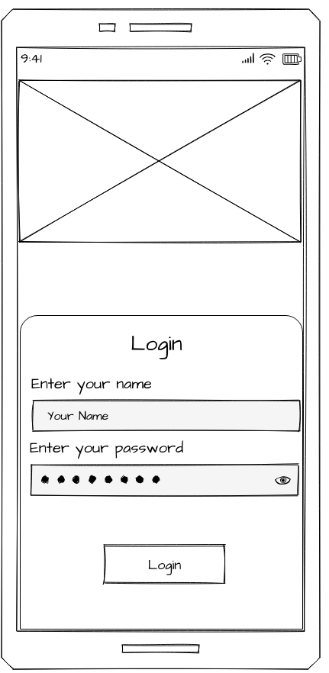
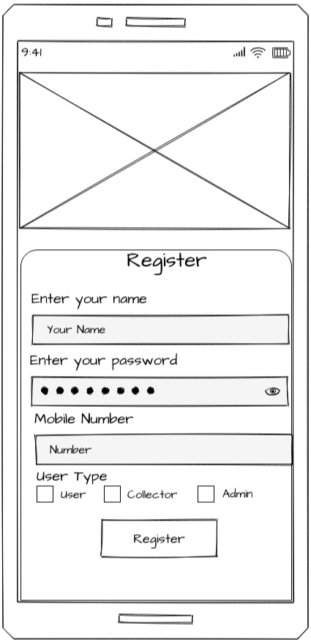
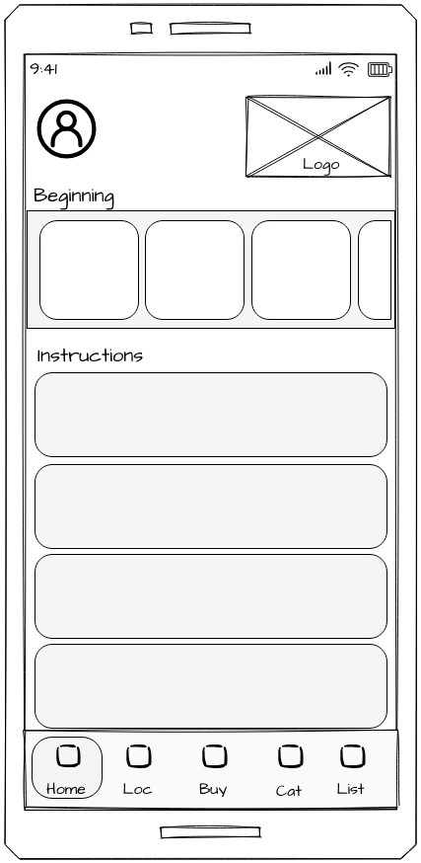
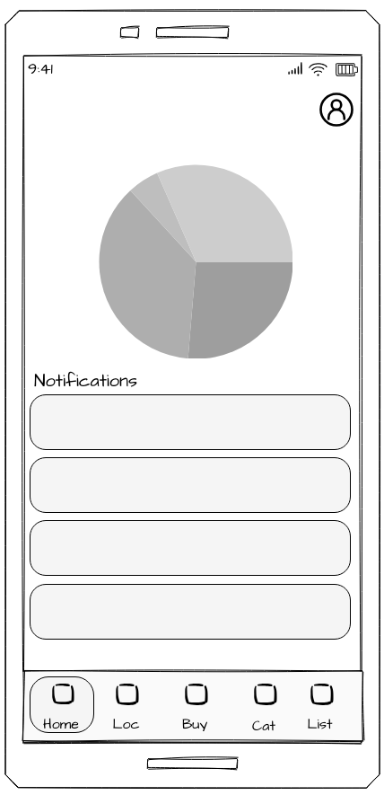
Wireframes - Sithumini K.G.P
7

Slide 9
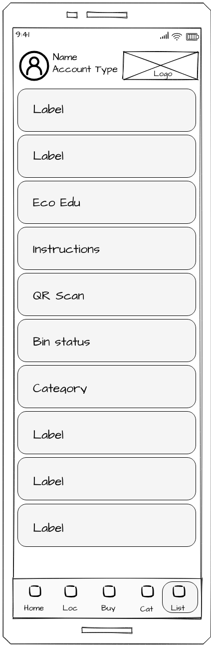
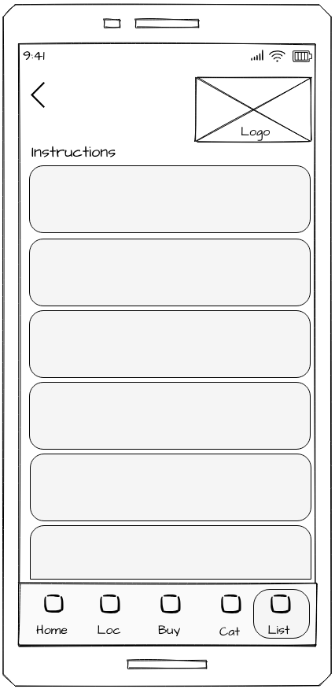
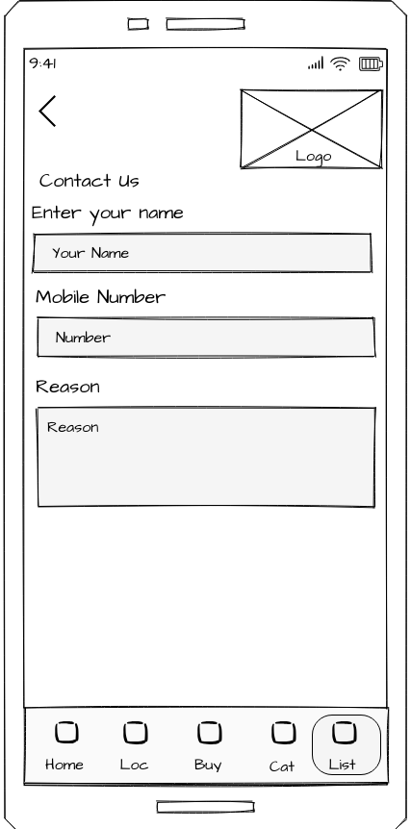
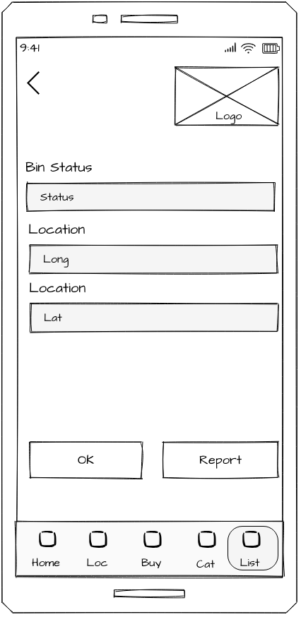
Wireframes - Sithumini K.G.P
8

Slide 10
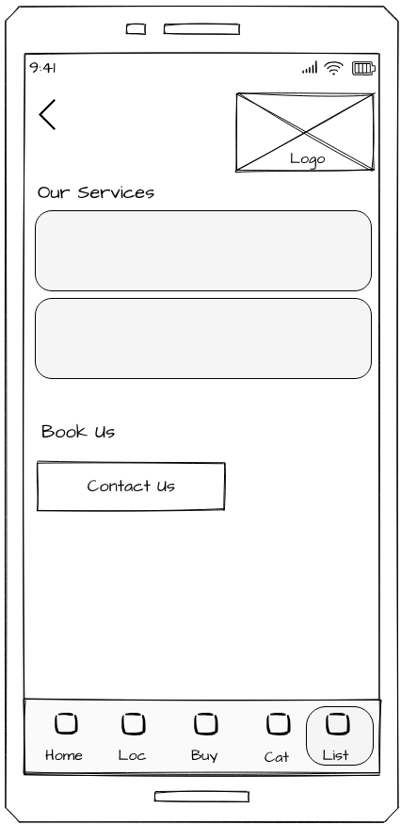
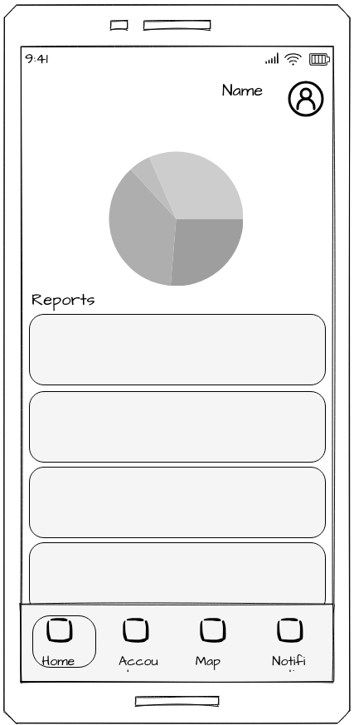
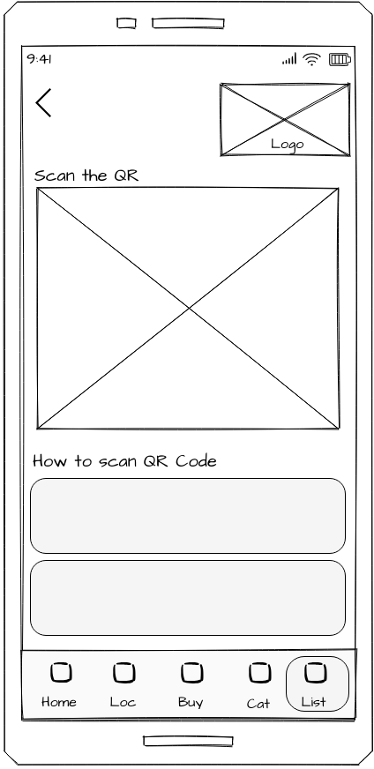
Wireframes - Sithumini K.G.P
9

Slide 11
Functions - Adhikari A.M.S.S
Novelties : Track the garbage locations with sensors
Track Nearest Garbage Bins
User can check nearest garbage locations when they are out of their home locations
Track Collector location and collected garbage
Locate garbage locations with using the sensors.
Confirm collected garbage bins so admin and user can view them real-time.
User can track garbage truck root way in the collecting time
Confirm pickup
User , Admin can view if the garbage is pickup or not.
Report Problems
User can report any issue on illegal dumping and vandalized places
10

Slide 12
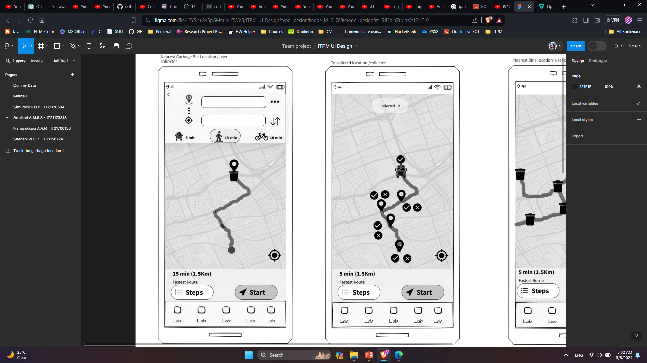
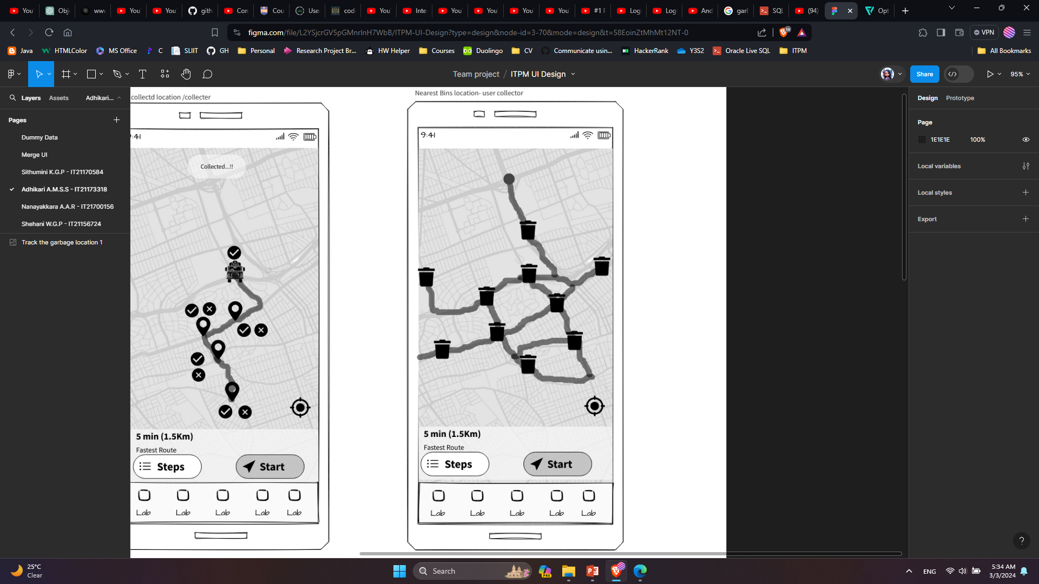
Wireframes - Adhikari A.M.S.S
11

Slide 13
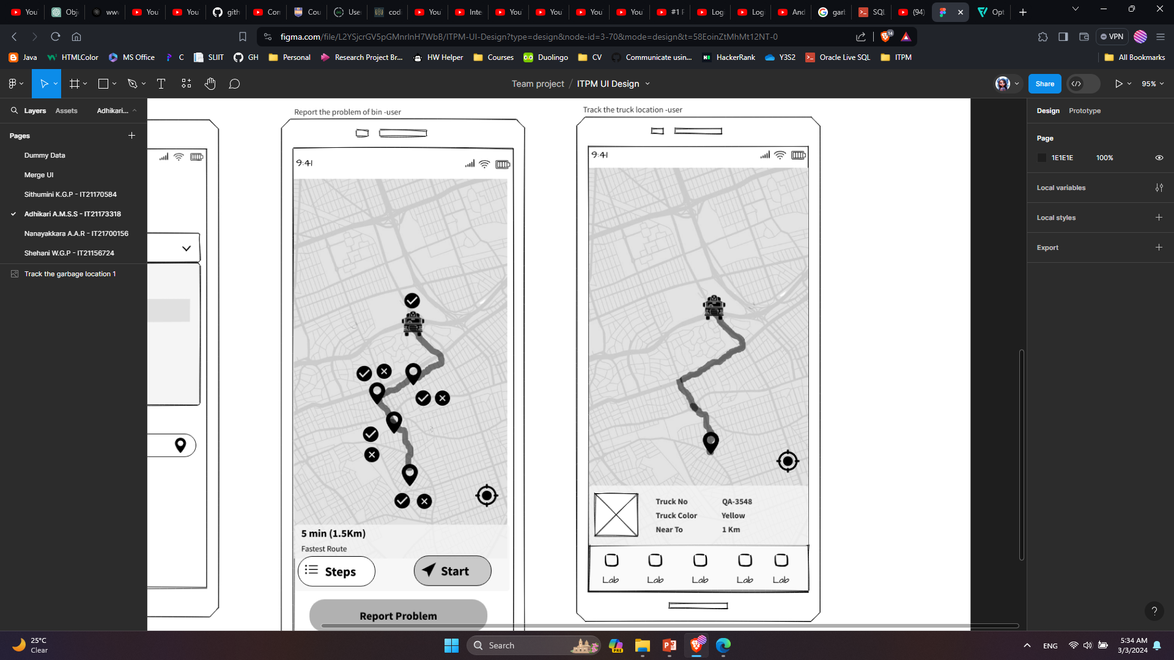
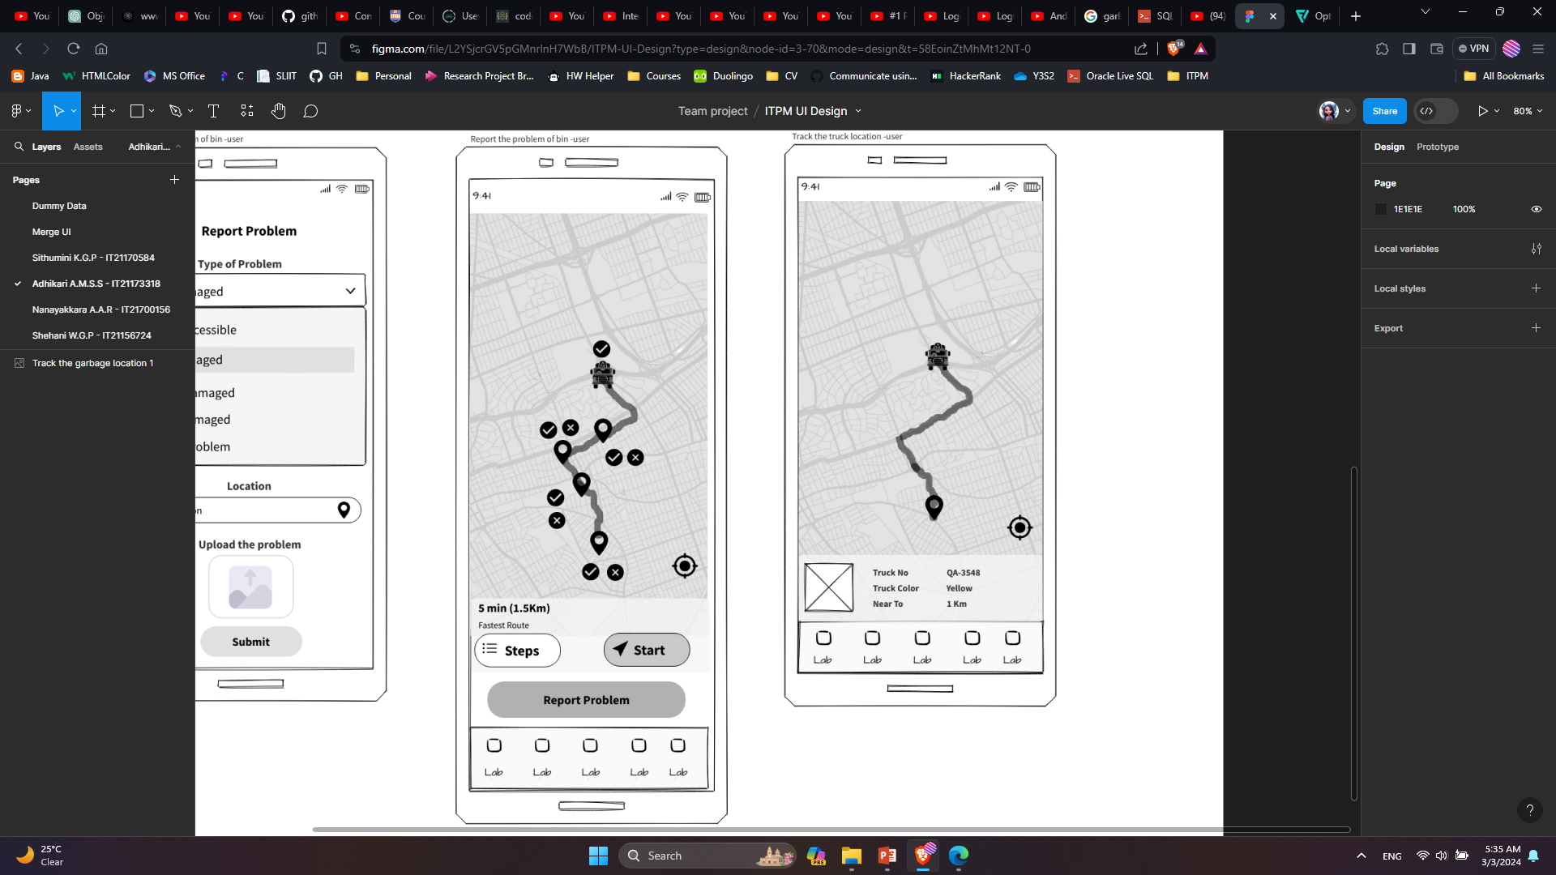
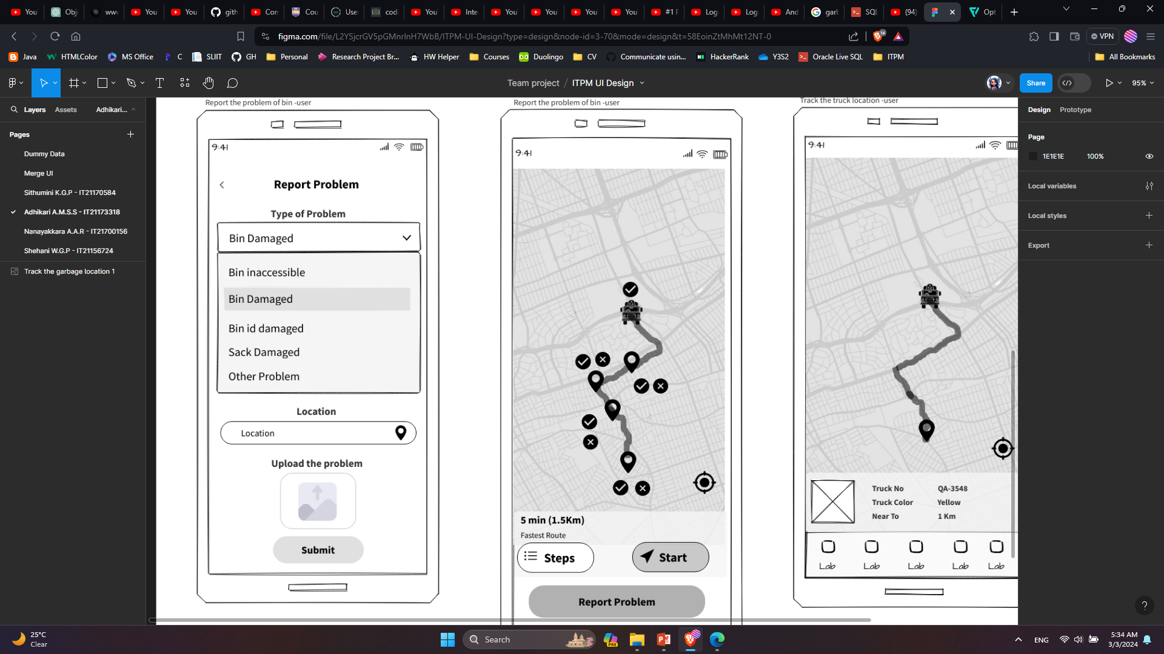
Wireframes - Adhikari A.M.S.S
12

Slide 14

Functions - Nanayakkara A.A.R
Buy and Sell page
Admin can sell the recycle items and user can buy them using the app
Feedback and Rate
Both user and collector can give feedback.
Collector can give user rate. Rates made user gets achievements based on their rate amount
Chat
User and collector can chat using chat function .
Feedback Report
Collector can generate a report about the given and got feedbacks.
13

Slide 15
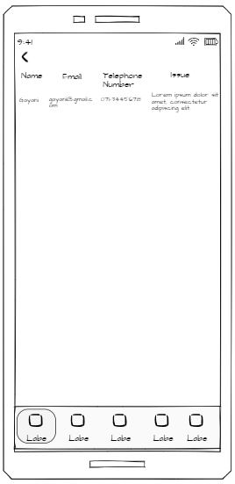
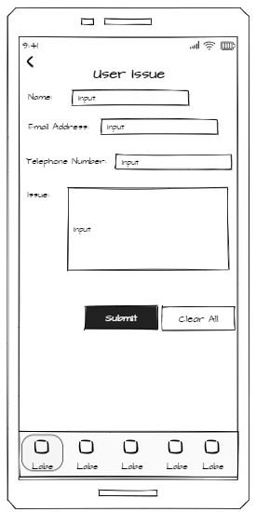
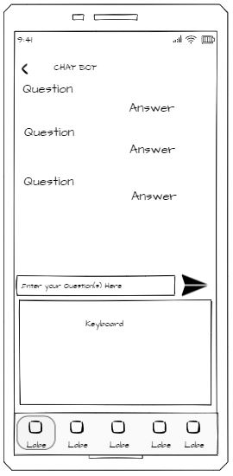
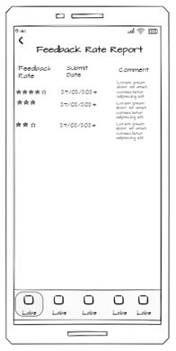
Wireframes - Nanayakkara A.A.R
14

Slide 16
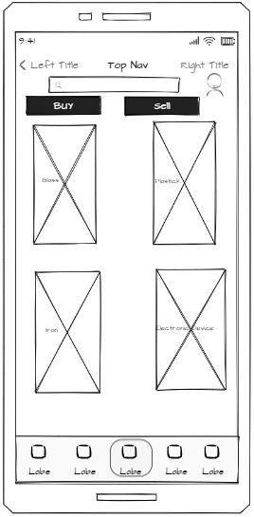
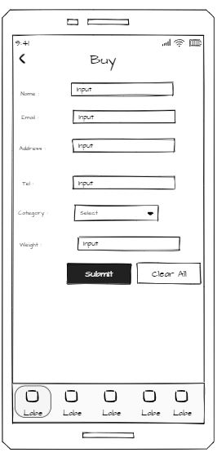
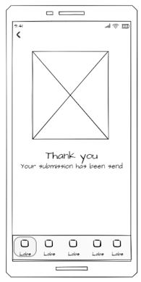
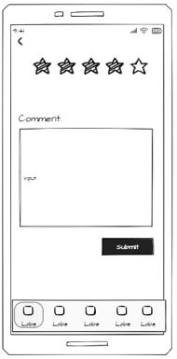
Wireframes - Nanayakkara A.A.R
15

Slide 17
Functions - Shehani W.G.P
Add Bins to the system
Add New Bins to the system.
View issues, collection details, garbage details
Can view users reported issues and collector's garbage collected details.
Categorize the garbages
Manage garbage according to various categories
Report Generation
Generate reports on garbage collection and sold items
16

Slide 18
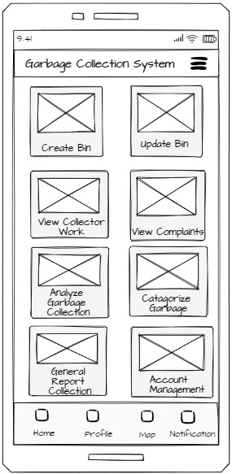
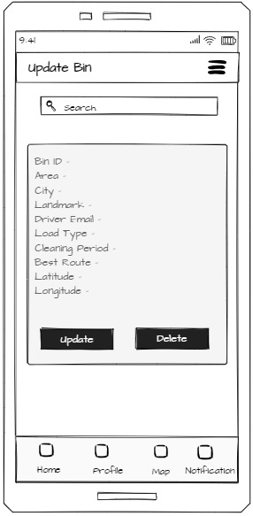
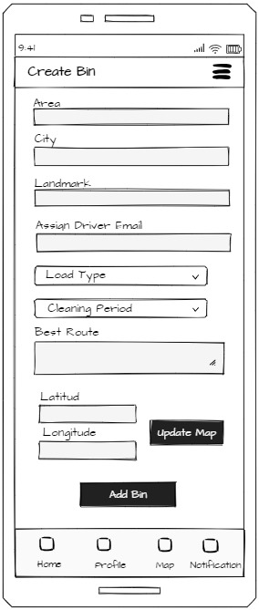
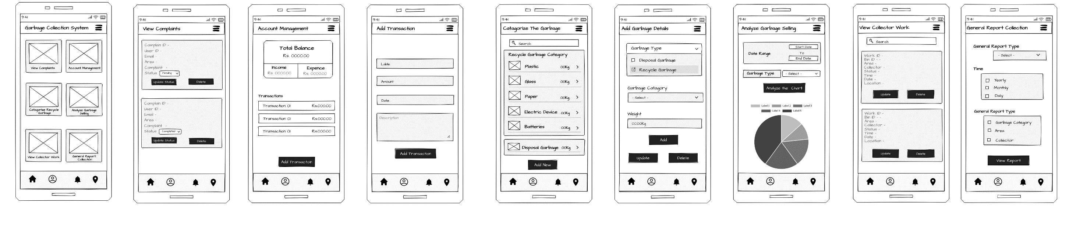
Wireframes - Shehani W.G.P
17

Slide 19
Wireframes - Shehani W.G.P
18

Slide 20
Literature Review
Tasks | RecycleNation | TrashOut | Litterati | Eco Clean
Check the bin status | X | X | X
Report Problems |  | X
Contact Admin
Education Services | X |  | X
QR Scans | X | X | X
Track collector locations | X | X | X
Rate User |  | X
Buy and sell recycle items | X | X | X
19

Slide 21
Gantt Chart
 | Week
Tasks | 01 | 02 | 03 | 04 | 05 | 06 | 07 | 08 | 09 | 10 | 11 | 12
Selecting Topic
Project Approval (presentation & wireframes)
Design High Fidelity Prototypes
Implementation
Progress Presentation
Research Paper
Integrating components and testing
Deployment and acceptance testing
Presentation and demonstration preparation
20

Slide 22
THANK YOU
Any Questions ????

